Slide 1
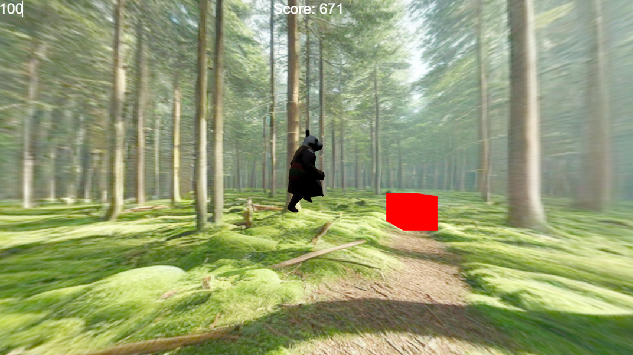
Panda Run
By Narcis-Andrei Tataranu

Slide 2
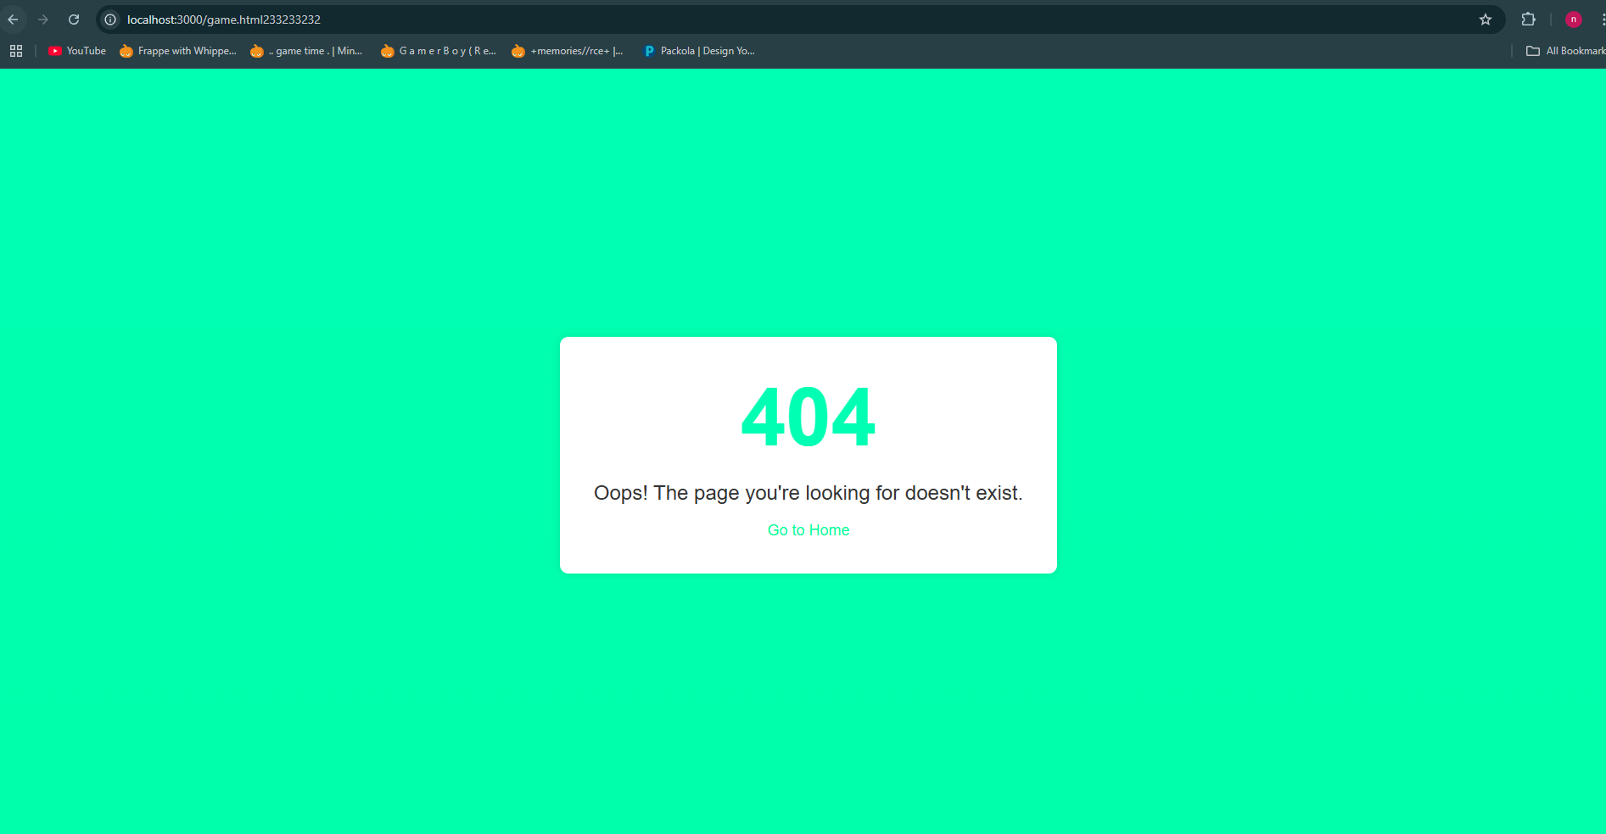
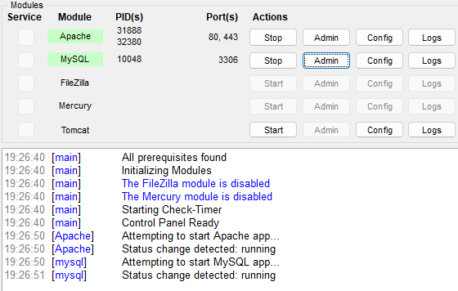
Server and 404 page
Figure 1. Invalid page
Figure 2. 404 Page
Figure 3. Server

Slide 3
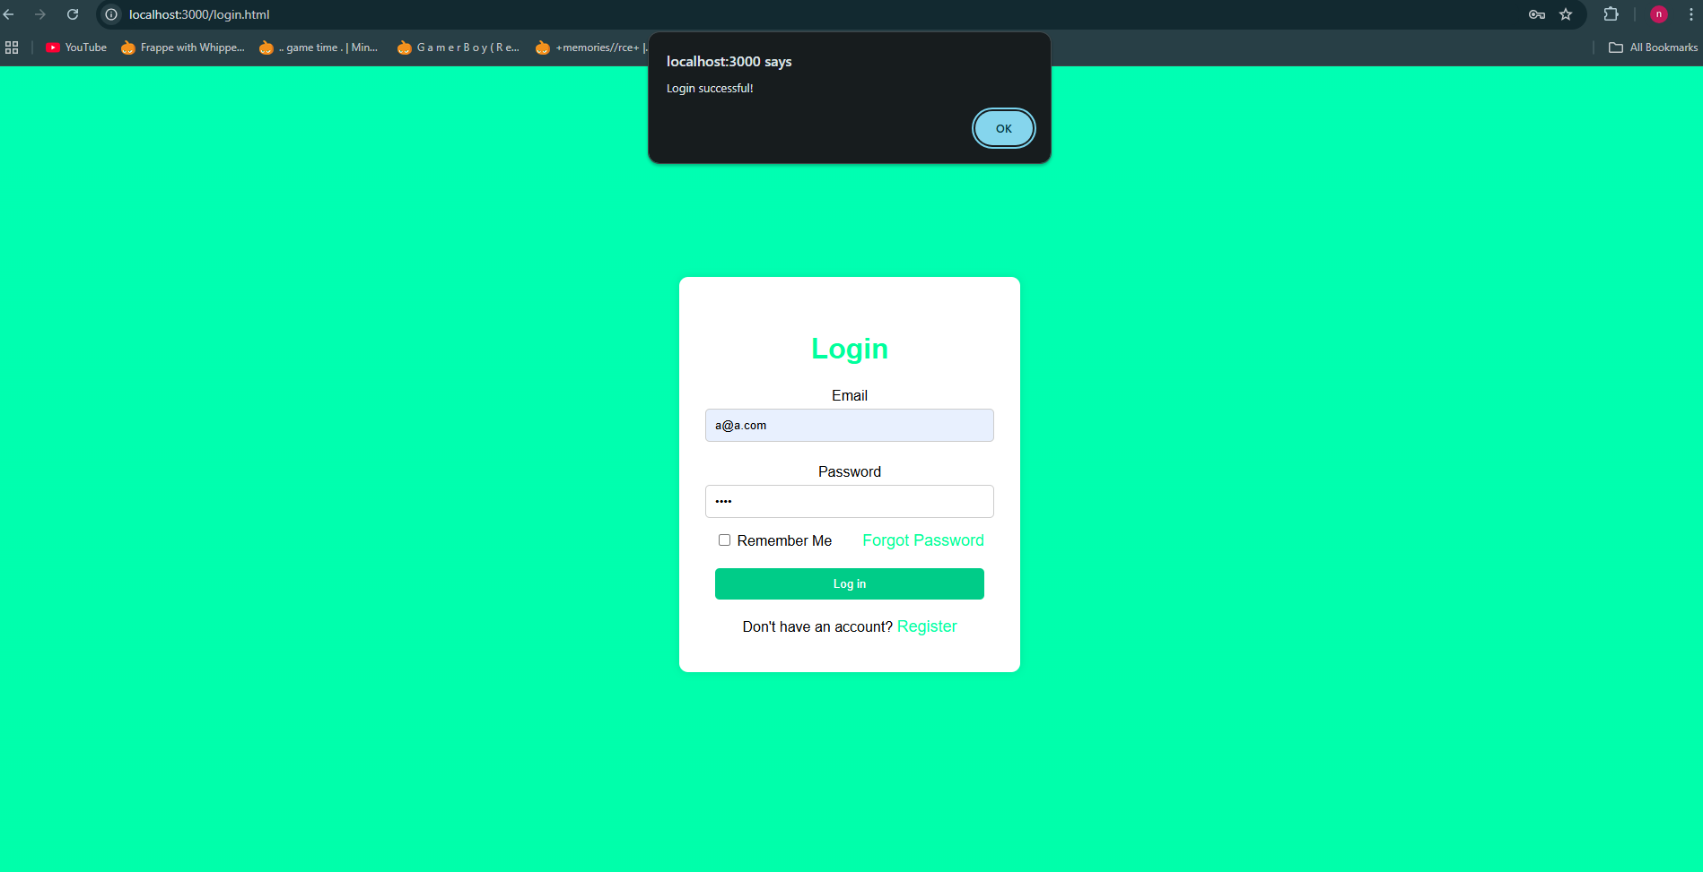
Working Login in
Figure 4. Login Page

Slide 4
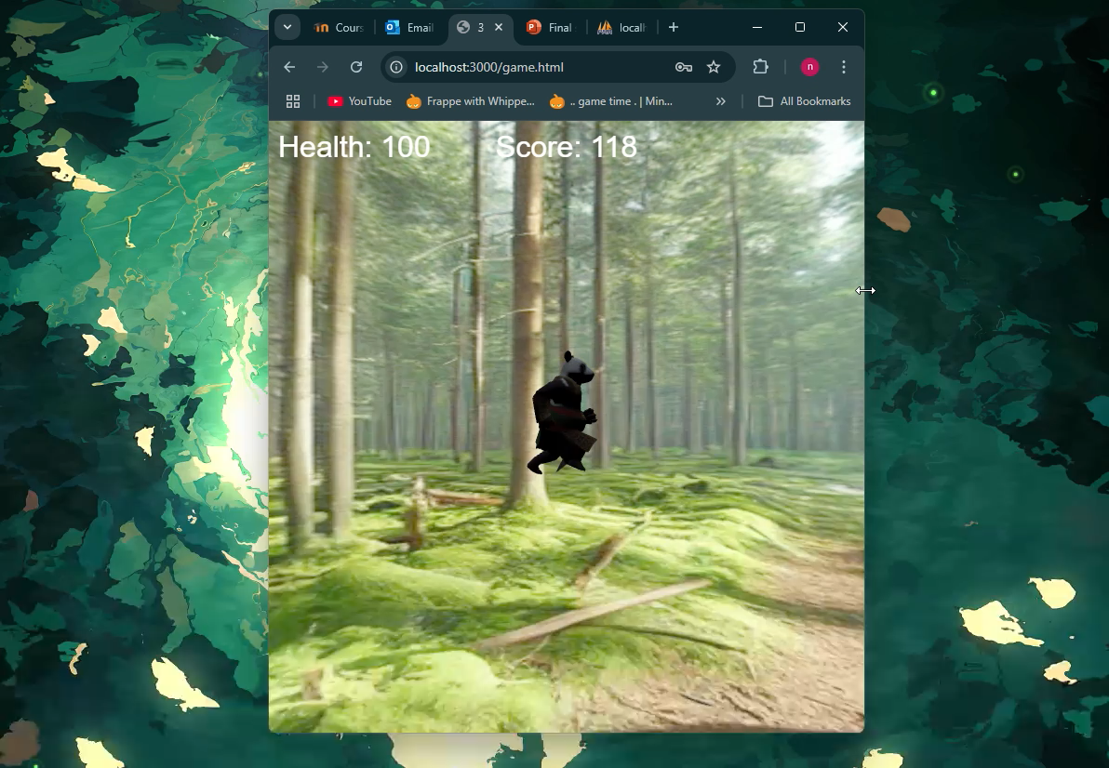
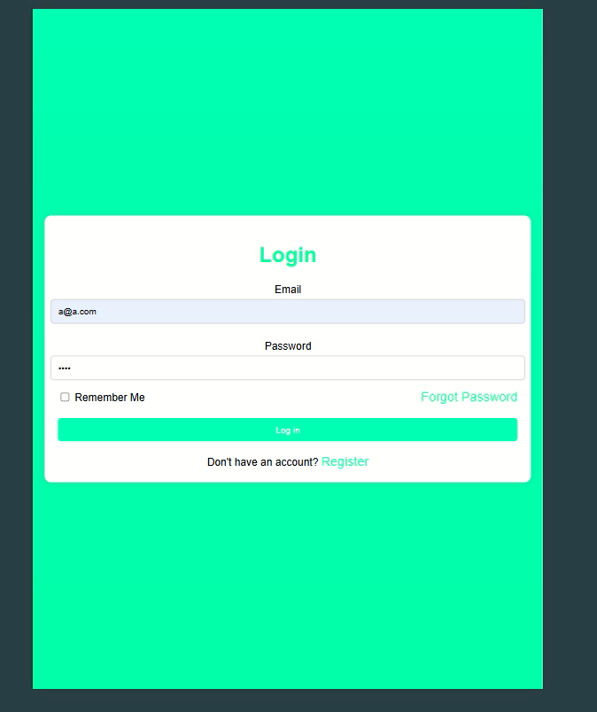
Responsive screen size
Figure 5. Responsive screen size
Figure 6. Responsive screen size

Slide 5
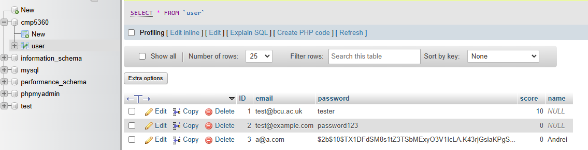
Secure User Login/Register Data
Figure 7. Saved Data

Slide 6
Any Questions?

